Slide 1
Exploratory Data Analysis

Slide 2
agenda
Introduction
Dataset Summary
Libraries Used
Visualizations and Descriptions

Slide 3
Introduction
The dataset contains the employment outcomes of engineering graduates as dependent variables (Salary, Job Titles, and Job Locations) along with the standardized scores from three different areas – cognitive skills, technical skills and personality skills. The dataset also contains demographic features. The dataset contains around 40 independent variables and 4000 data points. The independent variables are both continuous and categorical in nature. The dataset contains a unique identifier for each candidate.
Our goal is to perform Exploratory Data Analysis on Aspiring Mind Employment Outcome 2015 (AMEO) dataset and share the insights gained by our analysis through vizualizations.

Slide 4
Libraries Used
Numpy
Pandas
Matplotlib
Seaborn

Slide 5
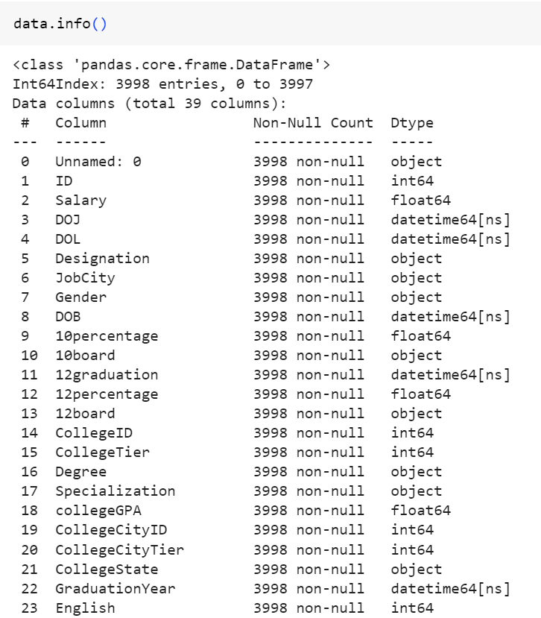
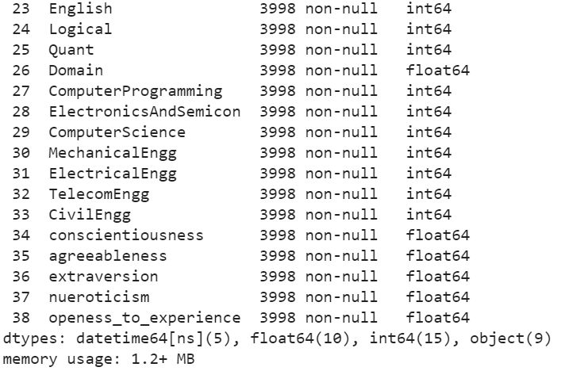
Information of the Dataset After Data Cleaning

Slide 6
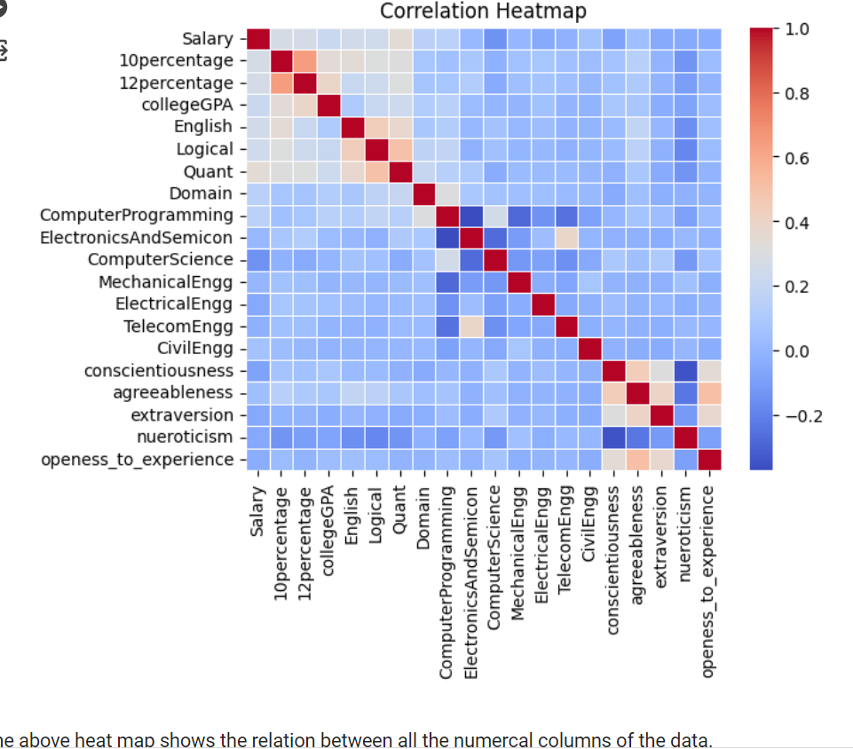


Slide 7
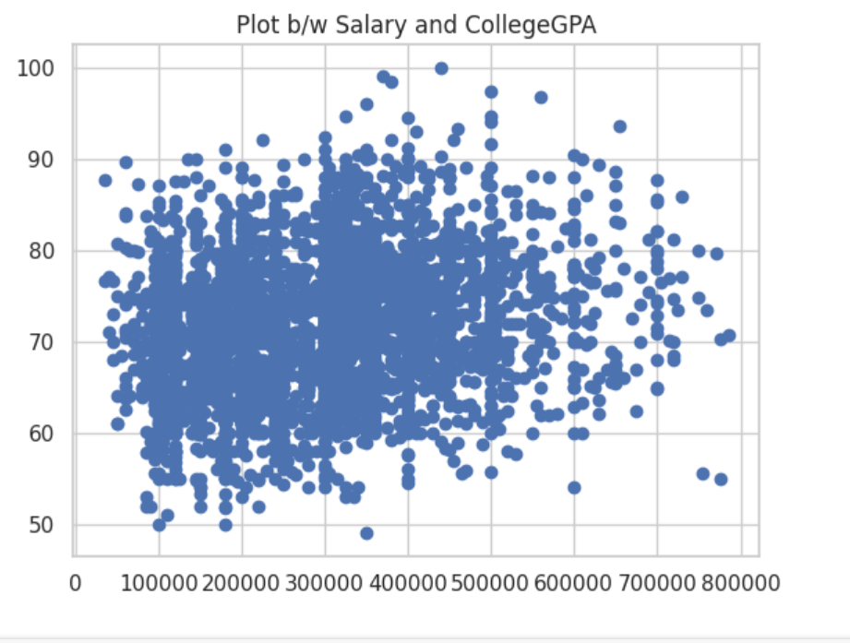
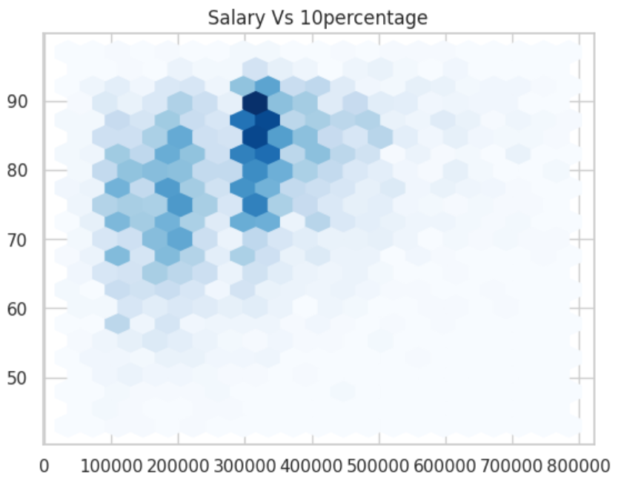

From the above both the graphs we can depict that marks are not the deciding factors for getting a high salary.
Observations:
most of the salaries are in the range of 3lakhs to 4lakhs
80% of the students who got high marks are also in this range of salary.
most who are earning above 6 lakhs are the students who scored below 80 perct in 10percentage and collegeGPA.

Slide 8
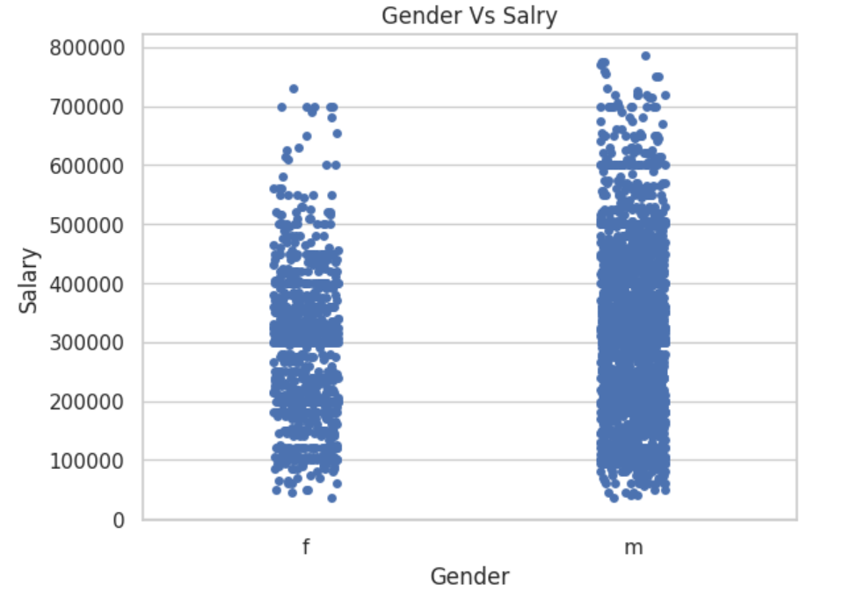
Observations:
on average both male and female earn around 3-4 lakhs.
Least salary for both the genders is around same.
compared to females, males are earning high salaries.

Slide 9
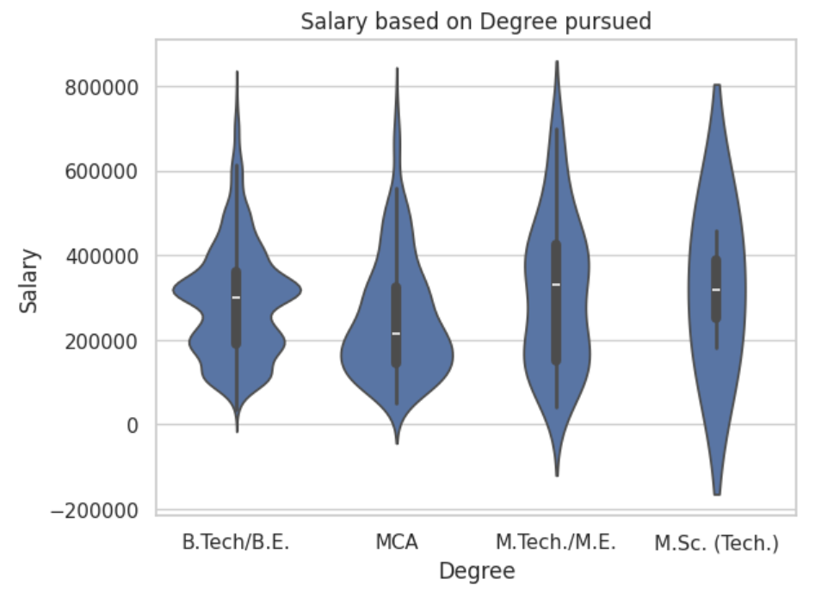
Observations:
M.Tech./M.E. has high average salary compared to other degrees. Followed by M.Sc.(Tech),B.Tech/B.E. and MCA respectively.
Highest salary is earned by students who completed M.Tech Degree.
Bulk of the graduates who pursed MCA are earning below 2lakhs

Slide 10
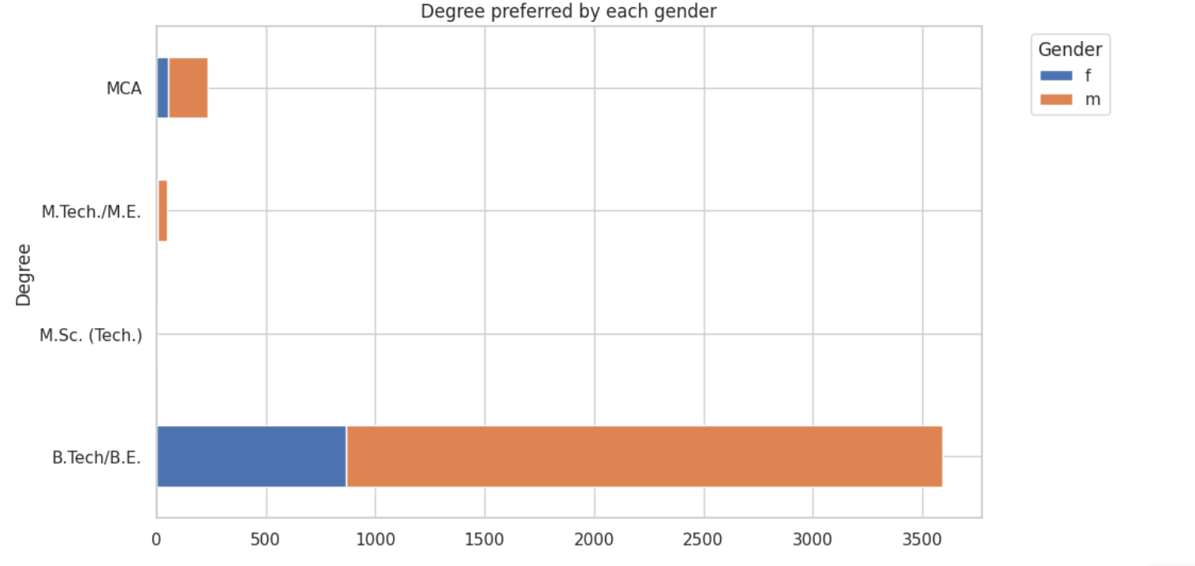
Observations:
most from both Gender prefer B.Tech Degree
Almost negligible from both the Gender prefer to pursue M.Sc
Females are less to pursue M.Tech when compared to males.

Slide 11
Thank you
Venkata Ajay Kumar Reddy Thumu
IN1240935
73339ajaykumar@gmail.com
+91 7660966715

